Slide 1
Climate Change: A visual through environmental shifts
Duy Mai
Hoang-Uyen Tran
Twan Tran
CECS 450 – Data Visualization

Slide 2
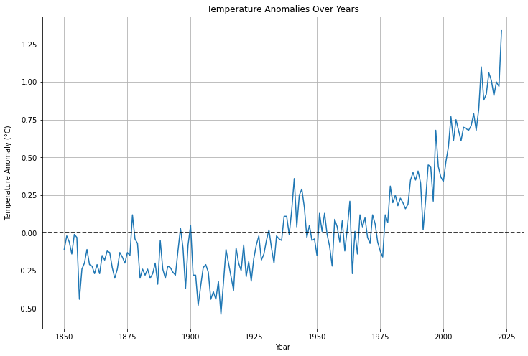
WHAT IS CLIMATE CHANGE?
Climate change, often referred to as global warming, or the greenhouse effect, is a change in the Earth's average temperature and cycles of weather patterns caused by human activities over a long period of time.
Since 1850, scientists have been documented global surface temperatures using thermometer-based records. The data trends show a consistent rise in temperatures, indicating a warming trend across the planet. This increase in temperature is a clear indication of the changing climate.
Greenhouse gases (GHGs) like CO2, CH4, and N2O are the primary cause.
GHGs create a blanket effect in the atmosphere, trapping heat.
Result: Earth's temperature increases.
Consequences: Extreme weather events, rising sea levels, and disruptions in ecosystems.

Slide 3
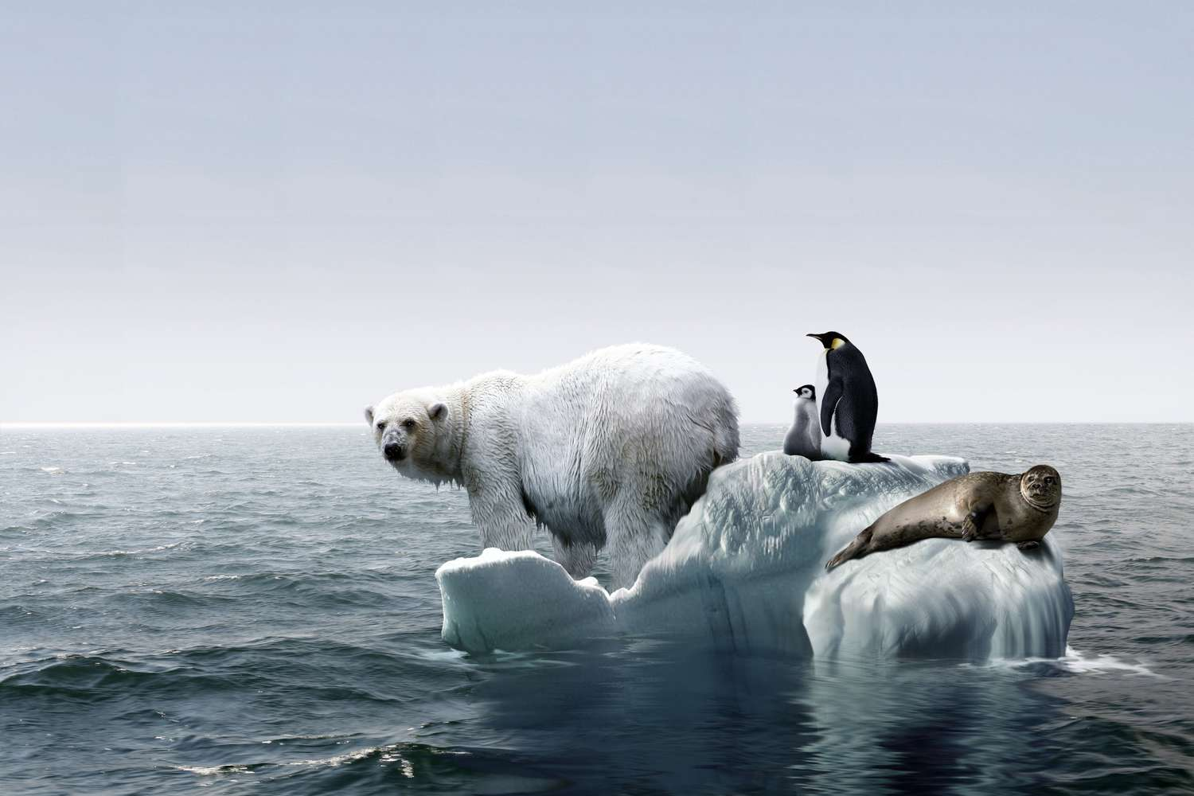
WHY IS IT A PROBLEM?
Species evolve slowly over millions of years to thrive in their unique environments. A stable climate supports this by allowing life to prosper and adapt. But rapid climate changes present a challenge: organisms have limited time to adapt. Swift alterations can leave some species struggling to survive, putting their existence at risk in the new environment.

Slide 4
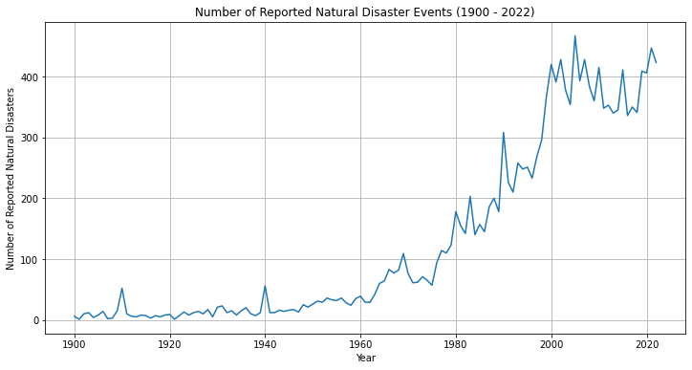
Why is It a problem?
Changes in the climate lead to disturbances in weather patterns, amplifying the frequency of extreme weather events. These encompass heightened hurricane activity, prolonged droughts, and escalated occurrences of floods. Concurrently, the surge in global temperatures parallels a noticeable uptick in documented natural disasters.

Slide 5
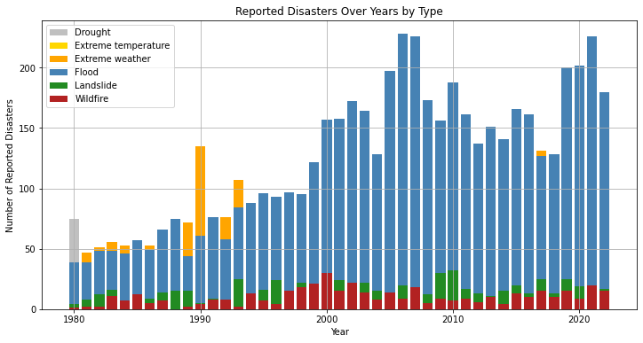
There has been a lot of flooding and landslide increasing with temperature rise
Why is It a problem?

Slide 6
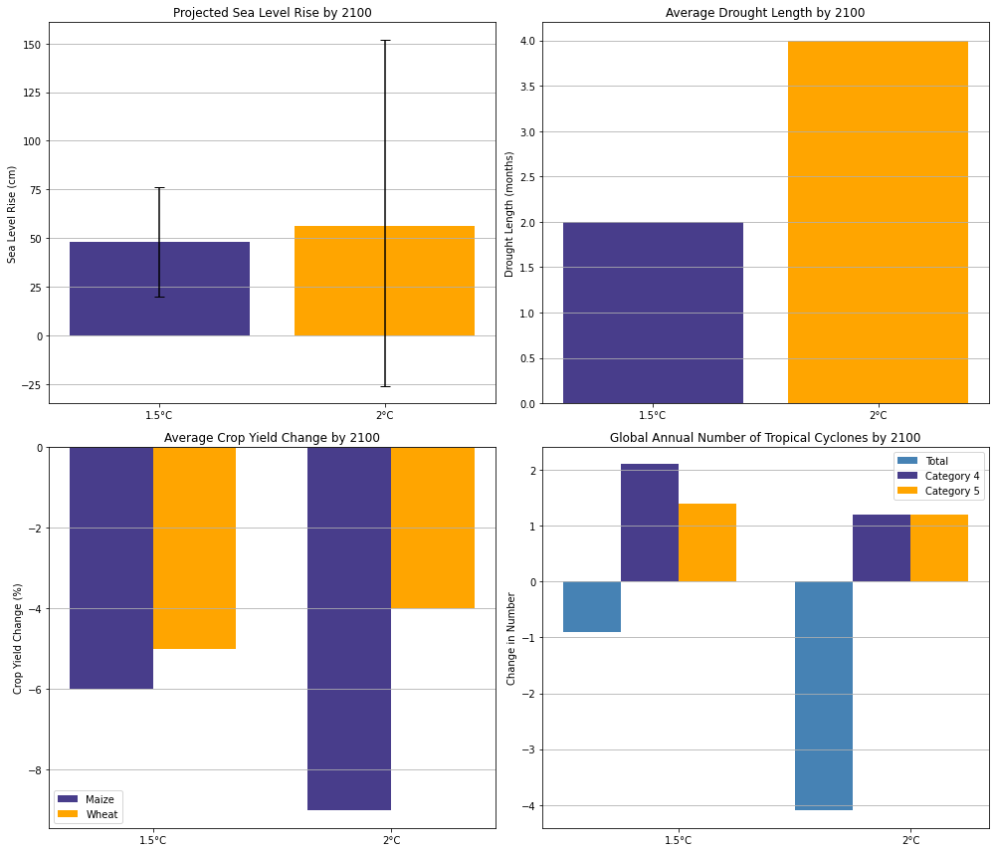
Why is It a problem?

Slide 7
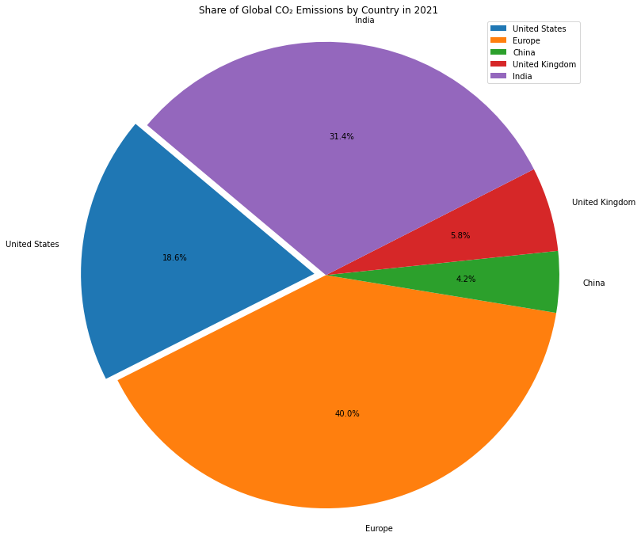
Who Causes Climate Change?
Around 1% of the greenhouse gases attributed to global warming are believed to have originated from the 50 least developed countries. In contrast, the contributions from the USA, the EU, and China alone account for approximately 60%.

